Slide 1
Los Altos Rotary Club Membership Update
October 18, 2012

Slide 2
15 New Members in 2011-2012
Jeff Baier
Jim Basiji
Lina Broydo
Linda Chin
Carol Garsten
Elaine Glissmeyer
Paul Gonella
Sally Meadows
Dennis Potter
Tom Powers
Norm Proffitt
Alison Salisbury
Ron Stefani
Donna Verna
Cruzie Wilborn

Slide 3
7 New Members (to date) in 2012-2013
Gary Brown
Ron Labetich
George Petroutsas
Harn Soper
John Evans
Gary Landis
Taylor Robinson

Slide 4
13 Members Departing in 2011-2012
Linda Chin
George Dai
Scott Fleming
Tatyana Kanzaveli
Shawn Kelley
Aileen Low
Seth Manning
Joanna Medin
Joan Rosselle
Jason Sanborn
Ken Schweifler
Lou Wellmeir
Don Witt

Slide 5
9 Members Departing (to date) in 2012-2013
Jim Basiji
Joe Corral
Roger Eng
Lauren Herbstmann
Jean Hollands
Mark Johnson
Baidra Murphy
Mike Stanley
Cruzie Wilborn

Slide 6
LARC Membership Count
2011-2012
Started with 169 members
Ended with 171 members
2012-2013
Started with 171 members
Currently at 169 members

Slide 7
What do these results tell us?
Membership contracting?
Natural attrition? (~50%)
Lack of engagement? (~50%)

Slide 8
What to do?
Bring in new members
Everyone’s responsibility
Membership Committee
Get new members engaged
Red Badge process
Sponsors
Mentoring program?

Slide 9
How to Bring in a New Member
Must be invited
“Guest of the Club” (3x free)
Submit Membership & Sponsor Applications
(cont.)

Slide 10
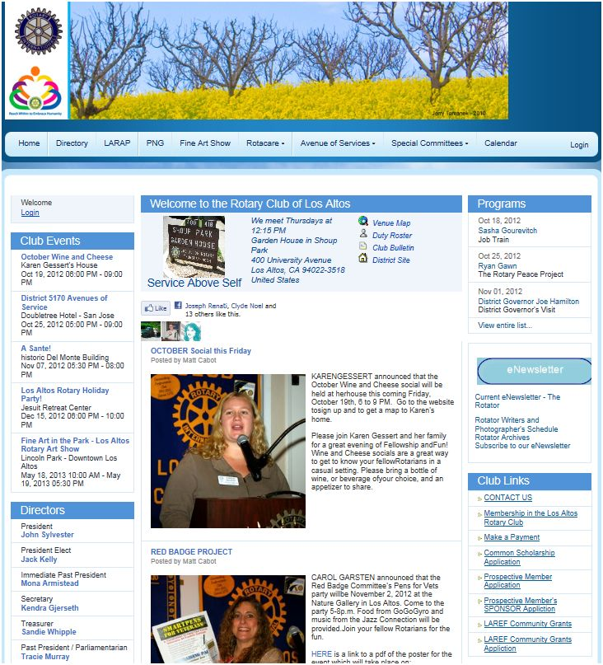

Slide 11
How to Bring in a New Member (cont.)
after applications submitted…
Board Approval
Orientation, Reference checks & Announcement to Club
Induction Ceremony
Continue to be their sponsor

