Slide 1
THE LOS ALTOS MEDIATION PROGRAM
PROVIDES IMPORTANT SERVICES TO OUR COMMUNITY

Slide 2
In a Variety of Disputes

Slide 3
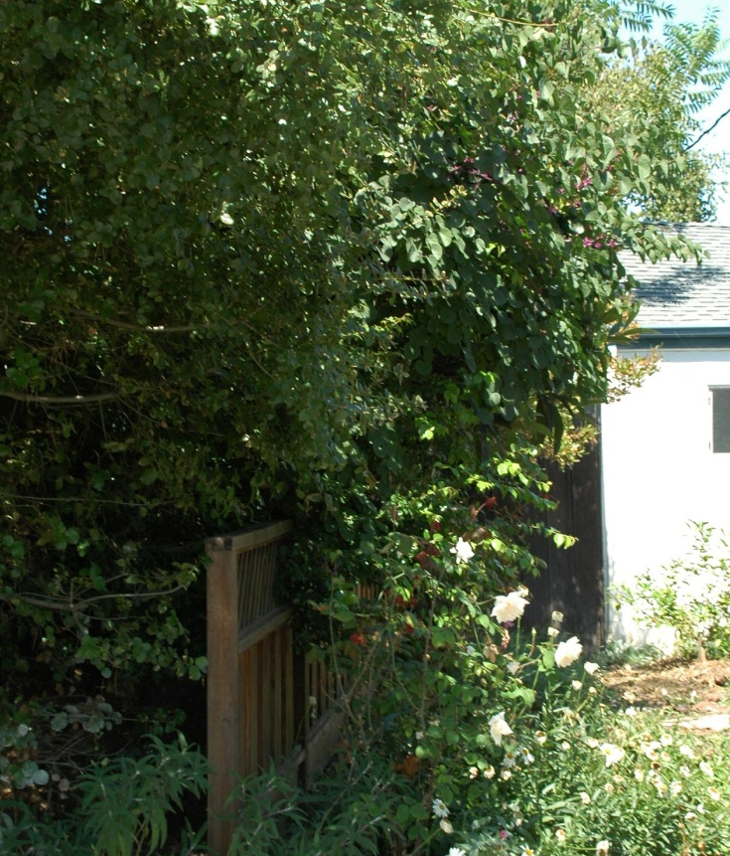
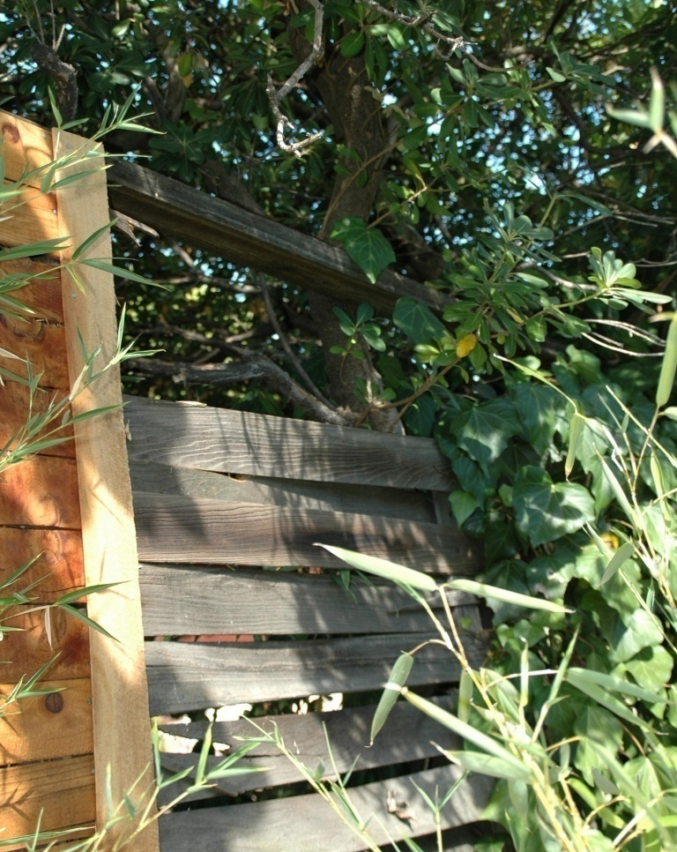
Neighbor-to-neighbor issues
Trees
fences

Slide 4
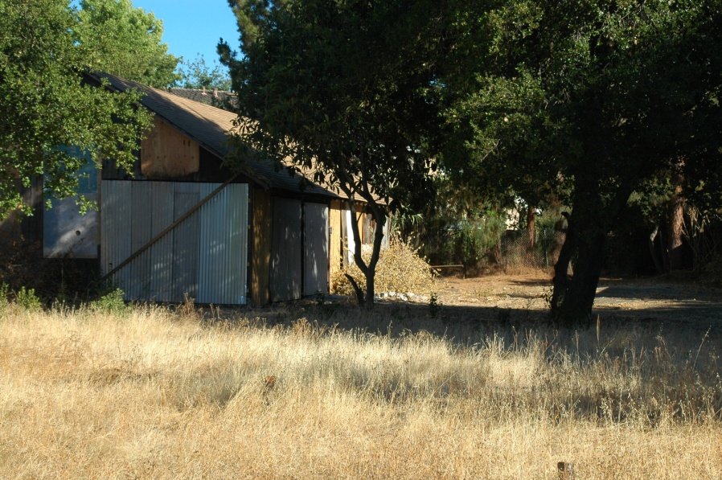
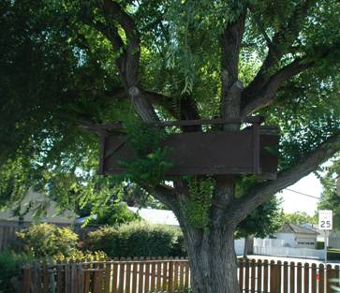
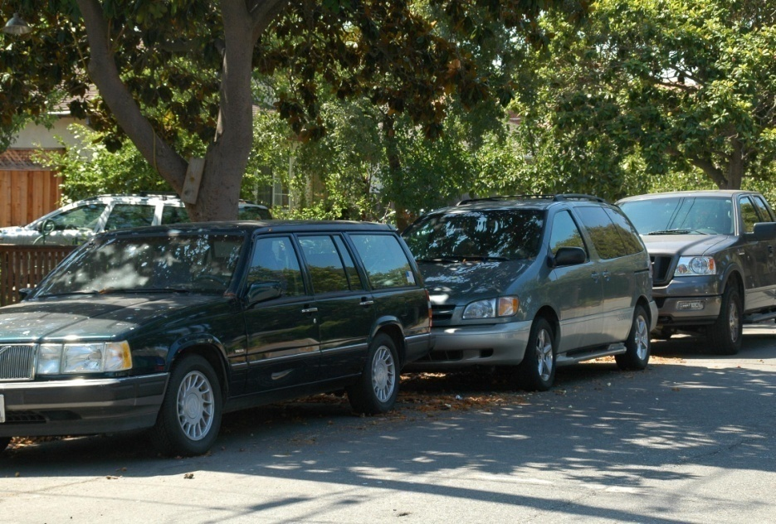
Land Use/
Boundaries
Parking

Slide 5

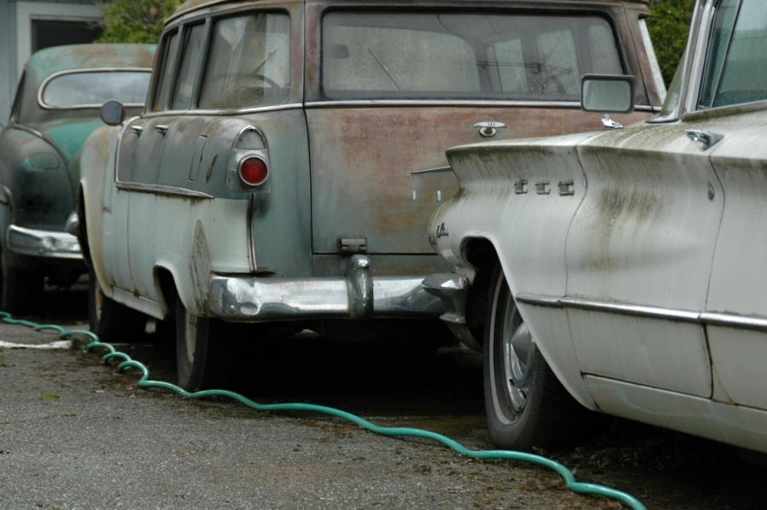
Pets
Eyesores

Slide 6
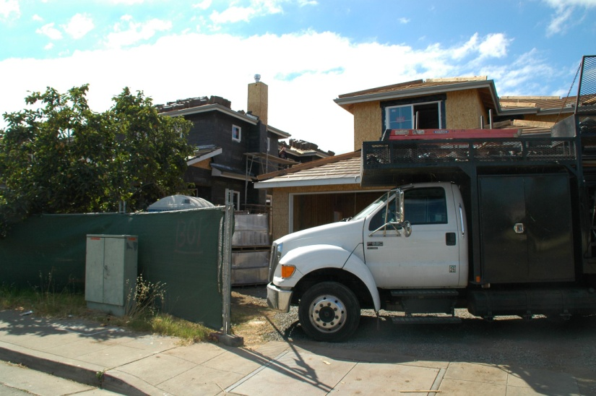
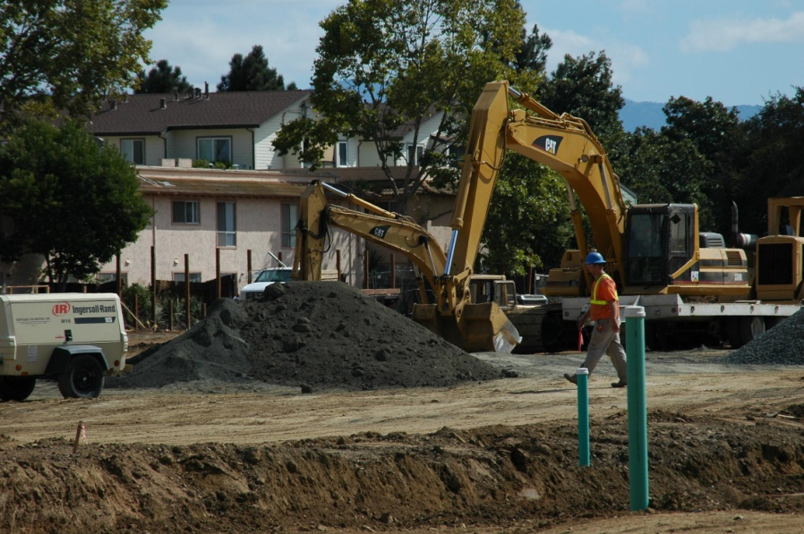
Construction
Noise
Disruption
Traffic
“Monster Home” impact

Slide 7
Tenant – Landlord Disputes
Rent Increases
Repairs
Deposits
Privacy vs LL right to enter
Eviction
smoking

Slide 8
In every housing situation
Noise
Children
Roommates
Caregivers
Lifestyles

Slide 9
In Condominium Communities
Where “one man’s ceiling is another man’s floor”

Slide 10
We can address the full spectrum of issues
Neighbor –to-neighbor
Owner - HOA
HOA Boards – Training and Meeting facilitation

Slide 11
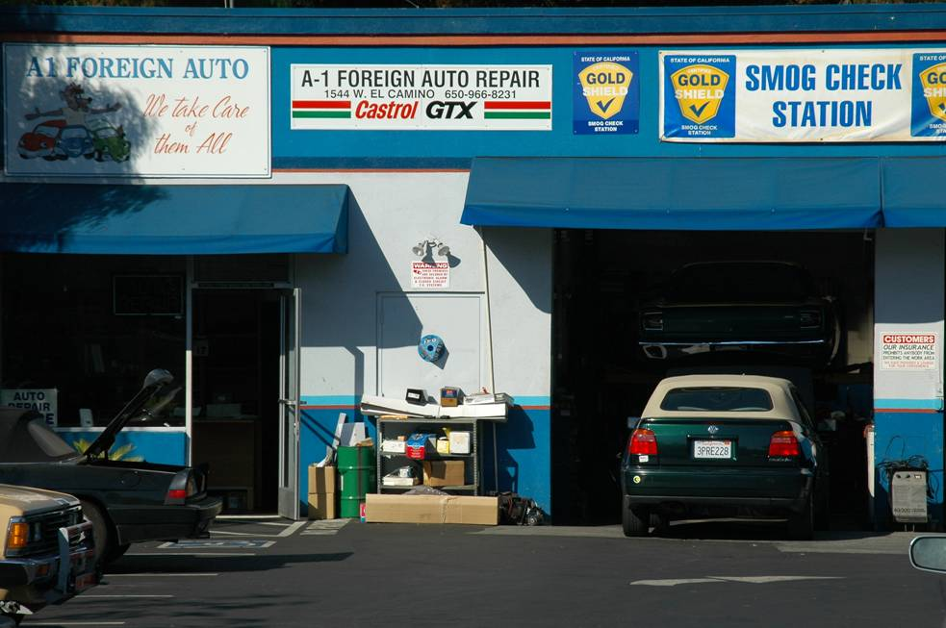
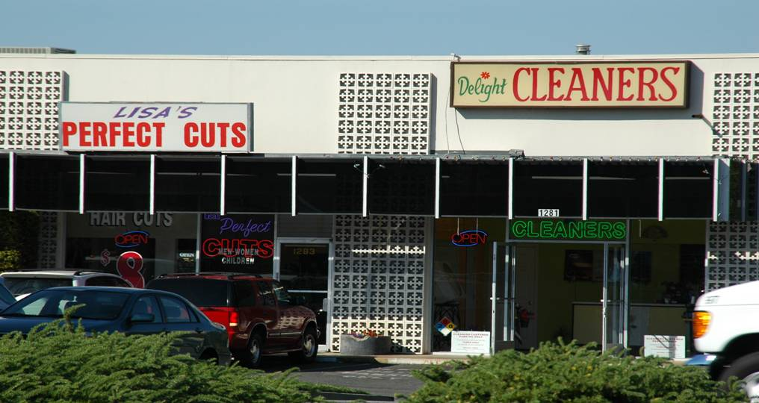

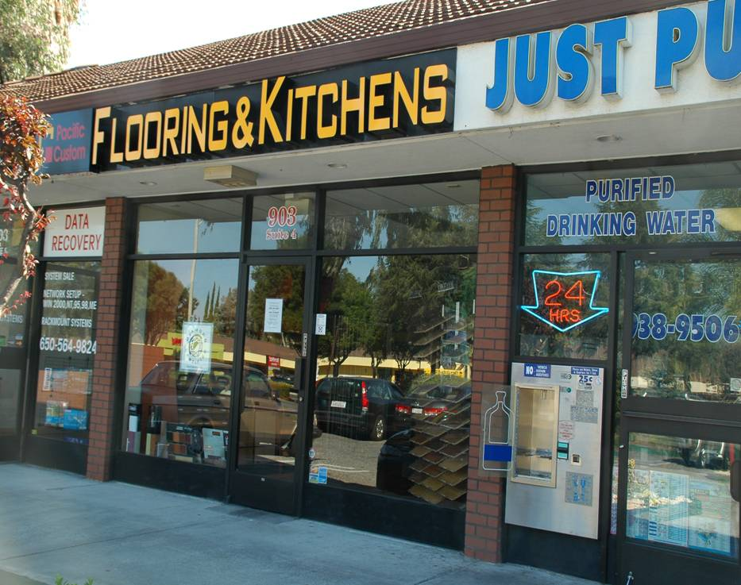
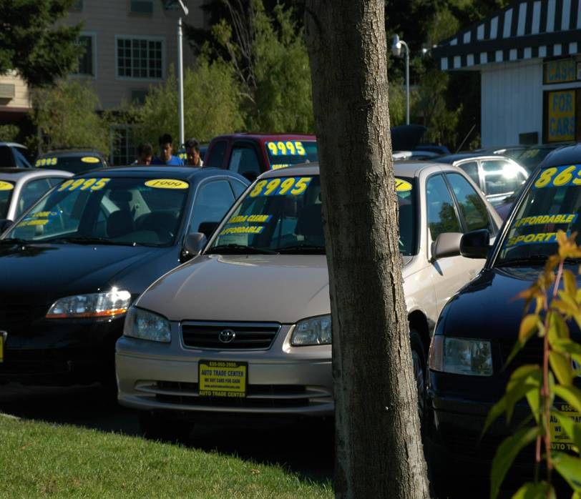
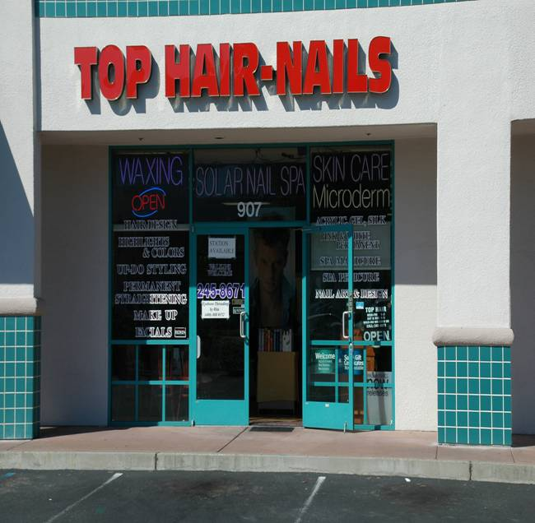
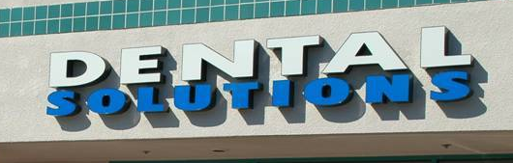
Consumer

Slide 12
We are also available to help resolve disputes involving
Workplace
School District
Parent-Teen

Slide 13
We Offer the Full Range of Dispute Resolution Options
Mediation
Telephone Conciliation
Information and Referral

Slide 14
Dispute Resolution Is the BETTER Solution
It’s Confidential
It’s Voluntary
It’s Neutral
It’s Effective
It’s Fast, Convenient
and it’s FREE !

Slide 15
We also provide,
Facilitation of sensitive community disputes
Conflict management training

Slide 16
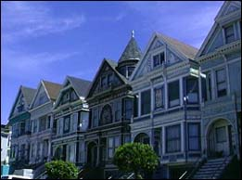
Additional Counseling Services available through Project Sentinel
HUD Certified Programs for
  Mortgage Default
  Below Market Rate
  First-time Homebuyer Instruction

Slide 17
The partnership between LAMP and Project Sentinel means
Local mediators, board and mediation sites
Professional administration and resources

Slide 18
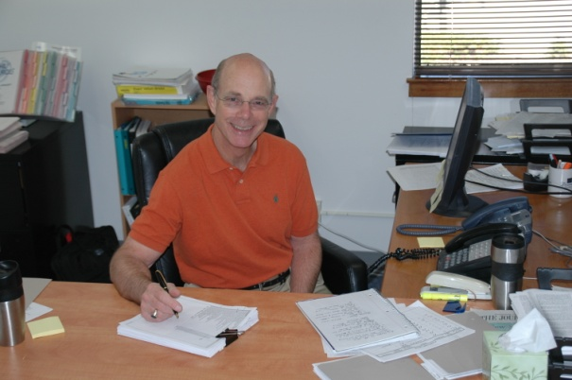
The Los Altos Mediation Program
A project of LACF
contact Ric at:
650-949-5267 mediate4lamp@projsen.org

Slide 19
Administered by PROJECT SENTINEL
Dispute Resolution Services
www.housing.org

